Slide 1
Nutrition App
Rob Wagner
Alex Petitjean
Ryne Bell

Slide 2
What is Nutrition App?
The core algorithm:
Markov Image Modeling
Clean, simple user interface
Mobile Android application
Three-tier architecture design

Slide 3
The Model
Functions on the principle of conditional probability
Our simple model is color-by-color based
Compares pictures by their transitional probabilities
Model could use improvement if project were to be continued

Slide 4
Requirements
An Android App that…
Has a simple, easy to use interface
Is small, and calculations are done off of the phone
Allows snapshot processing and identification
Is localized!

Slide 5
Our Solution
Image processing occurs on the phone
Processed image model is sent to the server
Food items are retrieved from the database
Server scores the model against other foods
Three most likely foods are returned to the user
Based on user input, nutrition facts are returned
User is happy, user gives us money

Slide 6
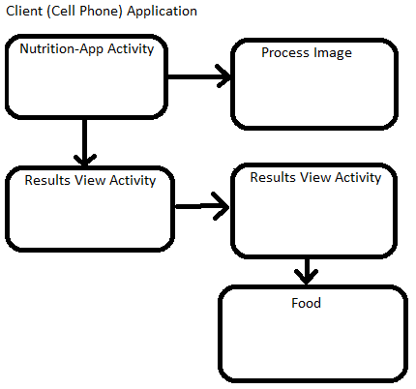
Client-Side

Slide 7
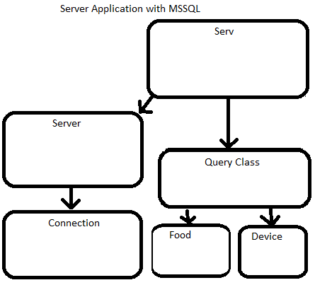
Server-Side

Slide 8
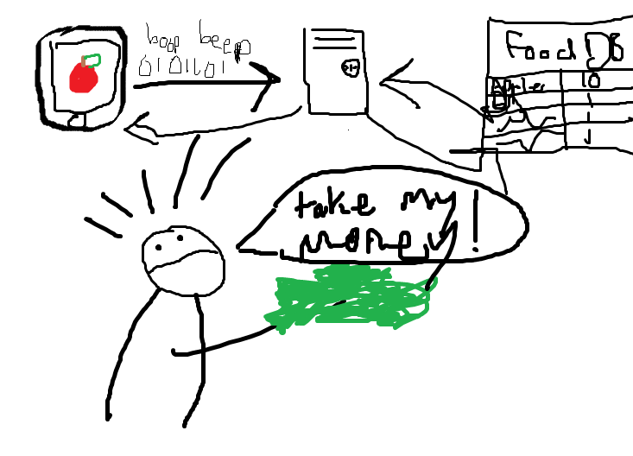
Relevant Diagram

Slide 9
Test-Driven Development
Struggled with it quite a bit
Often difficult to write tests when we weren’t sure what tools we were going to use
When we buckled down toward the end and did TDD it worked well
Would have probably been a better TDD experience if we had been more diligent

Slide 10
Metrics
Method lines of code
Keep code clean and manageable
Cyclomatic complexity
Keep code simple
Depth of inheritance
Keep design simple
Nested block depth
Break up code if needed
Afferent coupling
Keep design simple
Lines of code
Track project growth

Slide 13
Demonstration

